Slide 1
MCCOG VE Installation Guide
Using the VE_Extras_MCCOG repository to install and use the VisionEval model for MCCOG
May 2026

Slide 2
Step 1: Clone the VisionEval-Dev and VE_Extras_MCCOG repositories
1.1 Use the RSG Github page to clone both the VisionEval-Dev and VE_Extras_MCCOG repositories using your Git-compatible software of choice.
VisionEval-Dev link for cloning: https://github.com/RSGInc/VisionEval-Dev.git
VE_Extras_MCCOG link for cloning: https://github.com/RSGInc/VE_Extras_MCCOG.git
Software options:
Gitbash: https://gitforwindows.org/
Github Desktop: https://desktop.github.com/
Tortoise Git: https://tortoisegit.org/
Preferred R IDE:
RStudio: https://posit.co/download/rstudio-desktop/

Slide 3
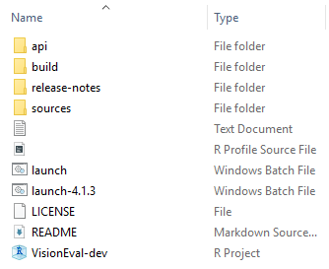
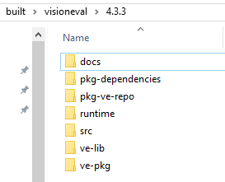

Step 2: Build the VisionEval model
2.1 Open the VisionEval-Dev folder on your local machine and open the VisionEval-Dev R project
Did You Know?
Note that the model is created under a folder named after the R version used when running ve.build(), e.g. built/visioneval/4.3.3. When running the model, the same R version must be used.
If using a different R version (e.g. 4.3.1), first the model must be built under that version and the model saved in built/visoneval/4.3.1 must be used to run the model.
2.2 Build the model by entering “ve.build()”. Depending on the speed of the machine, this will likely take several hours. “Build complete” will appear at the end. The command creates three new folders. The model directory is created under built/visioneval/{Rversion}
Created folders ->
Model directory ->

Slide 4
Step 2: Build the VisionEval model
Customize your runtime with MCCOG Specific VE Modules
MCCOG VE Extras
This Repo stores specific VisionEval files for the Central Indiana model such as packages for model runs and any custom models.
The synthetic population for the Central Indiana model is created using VEPopulationSim which uses the open-source package PopulationSim
Powertrain and Fuels information are held in the VEPowertrainsAndFuelsIndy. The packages VEPowertrainsAndFuelsMCCOG2024 and VEPowertrainsAndFuelsMCCOGEVs are packages for the multiscenario models.
Teleworking and sensitivity to built land use form are both accounted for in the VETravelDemandWFH package.
VEHouseholdVehiclesDL, VELandUseDL and VETravelPerformanceDL reflect driverless and car service modules

Slide 5

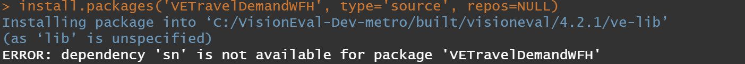
Step 3: Install Packages to the VE Library manually
3.1 Open the VE_Extras_MCCOG folder and open the VisionEval-dev R project
3.2 Add the absolute path of the ve-lib folder in the model directory (built/visioneval/{Rversion}/ve-lib). Use the “.libPaths” command:
3.3 Use the “install.packages” command to install the desired VE modules (the additional commands “type” and “repos” are required as pictured).

Slide 6
Step 3 cont’d: Install Packages to the VE Library manually
3.4 Troubleshoot
Install attempts may display a specific error or R packages that need to be installed prior to installing the VE module.
In this case, the user needs to enter install.packages(“sn”) to install the sn package prior to installing VETravelDemandWFH.
Using this method will install the packages directly into the VE Library of the built runtime

Slide 7
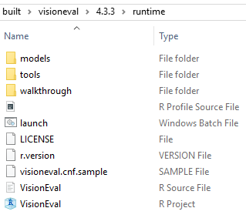
Step 4: Install and run a VE Model
4.1 Open the VisionEval R project in ...VisionEval-Dev/built/visioneval/{Rversion}/runtime
Open "C:\VisionEval-Dev\built\visioneval\4.3.3\runtime\VisionEval.Rproj"
R Studio should open to the Runtime environment for VisionEval.

Slide 8
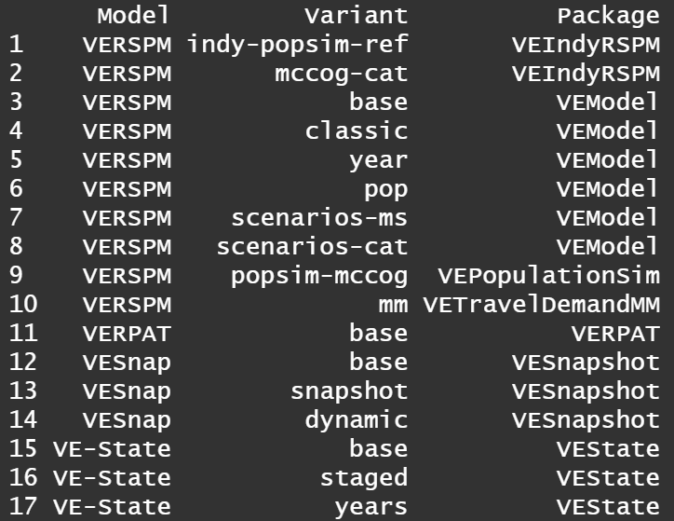
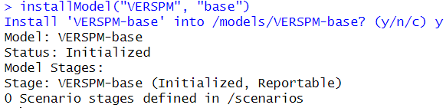
Step 5: Install and run a VE Model
5.1 Install VERSPM variant
To view the available VE variants enter showModelIndex().
Select a variant and install using the following installModel command structure:
installModel(“VERSPM”, “base”), and enter “y” when prompted
Variants are specific VisionEval models with unique run scripts, input files, and packages that are called during the run_model.R script.

Slide 9
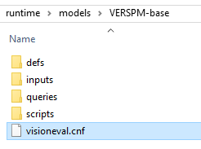
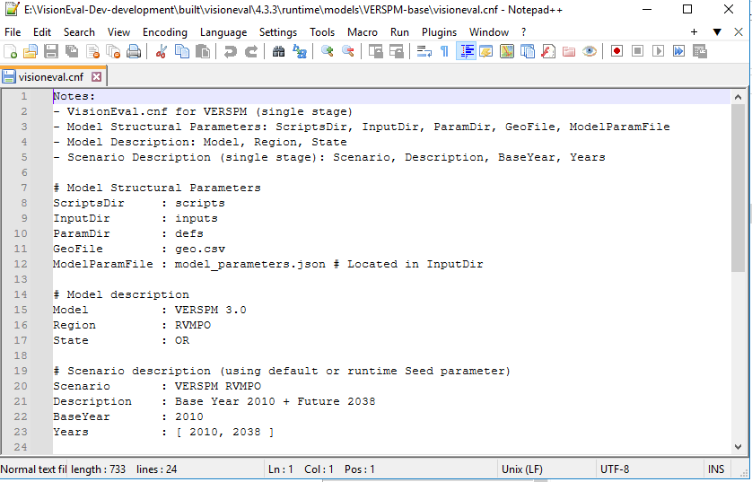
Step 5 (cont’d): Install and run a VE Model
5.2 Set the Model Configuration
After the model has been installed. Three folders are added to the models/ "name of installed model"
Open up the .cnf file. This file provides background information on the model variant. Most importantly it includes information on the base year of the model and the model years it will include when it runs.
The example shows the two years of 2010 and 2038 being run. Additional years can be run (as long as inputs have been provided). Note – the base year model year needs to be included in the "Years".

Slide 10
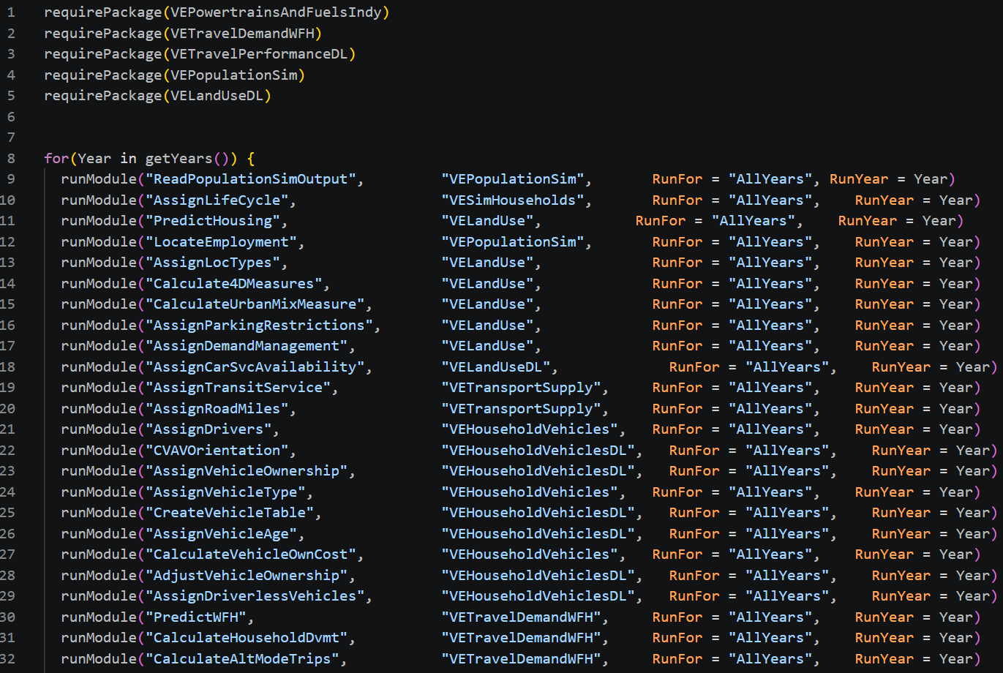
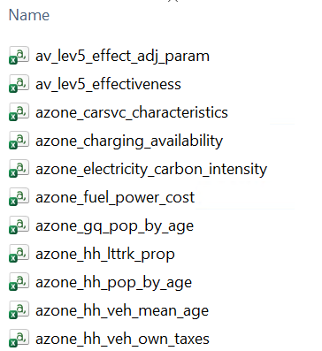
Step 5 (cont’d): Install and run a VE Model
5.3 Update model inputs
Update input files in the {model_name}/inputs folder
Update the run_model.R script in the {model_name}/scripts folder to reference the right modules and packages
All packages listed in the file must be in the ve-lib folder
run_model.R
Inputs

Slide 11

Step 5 (cont’d): Install and run a VE Model
5.4 Open the model and run
Open the VisionEval R project in the runtime folder
To run the model, first store the model as an R object named model using:
Then enter model$run() and ensure the model initializes. VisionEval uses this process to validate that the inputs are all in the anticipated format and there are no missing values across the various geographic levels.

Slide 12
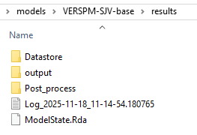
Step 6: Extract Model Results
6.1 Extract VE Model Run Results and Filter to the Target Rule Area
Once the model has finished running, use the built in VE export functions to export the model data as CSV outputs using the following code (note that “model” here is the name you called your model):
This will export the results as CSV files to the “results/output” folder. Depending on the number of years in the model, this process could take 15-20 minutes.
Did You Know?
Export default is to CSV format. SQL is another common format for the export.

